Slide 1
Emerging Role of Cloud Computing in
IoT-enabled Industry 4.0
Debashis Saha
IIM-Calcutta,
Joka, D. H. Road, Calcutta 700 104, India
ds@iimcal.ac.in

Slide 2
Outline
Introduction to “IoT”
Trends in IoT usage
IoT ecosystem overview
Research directions
Industrial IoT & Industry 4.0
Cyber-Physical-System (CPS)
Emerging role of cloud computing
Cloud of Things (CoT)
Conclusion
Business case

Slide 3
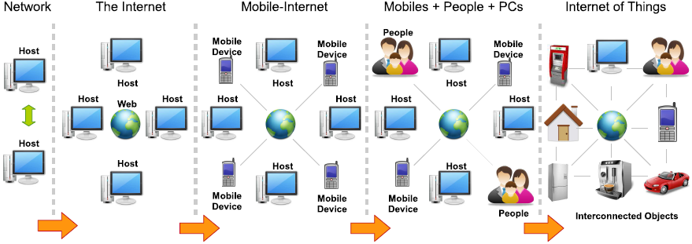
Where are we now in 2016 ?

Slide 4
ICT Evolution at a glance
Personal ICT 1980
Personal Computer (PC) for you alone
Distributed ICT 1985
Advent of LANs and then the Internet
Web-based ICT (Personal Mobility) 1990
World Wide Web (WWW) following the Internet
Grid-based ICT (Utility Model) 1995
Similar to power grid concept
Mobile ICT (Terminal Mobility) 2000
Cellular mobile technology
Cloud-based ICT (Service Model) 2010
Handheld devices as thin client
Pervasive ICT (Ubiquity) 2020
Internet of Things, Industry 4.0, Smart city, etc.

Slide 5
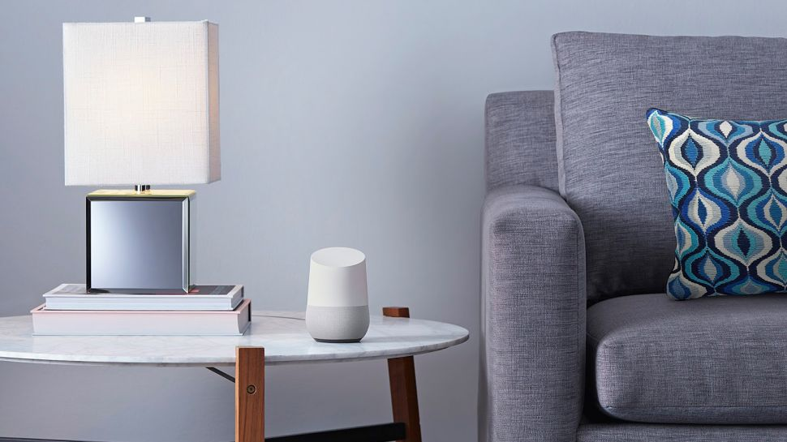
Can you name this object
Can You Name it?

Slide 6
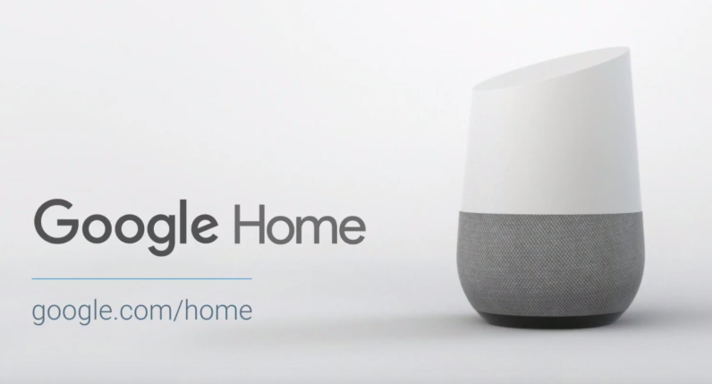
Unveiled on 18 May 2016 in Google I/O Show
https://www.youtube.com/watch?v=5bYSX2C4aWc

Slide 7
Watch the video

Slide 8
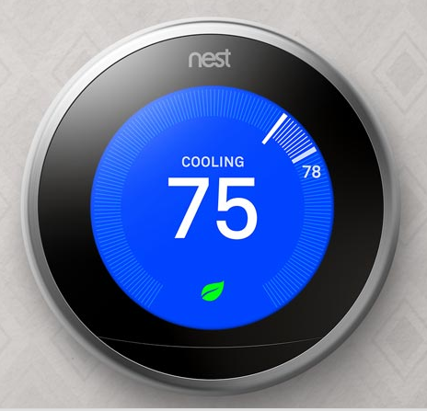
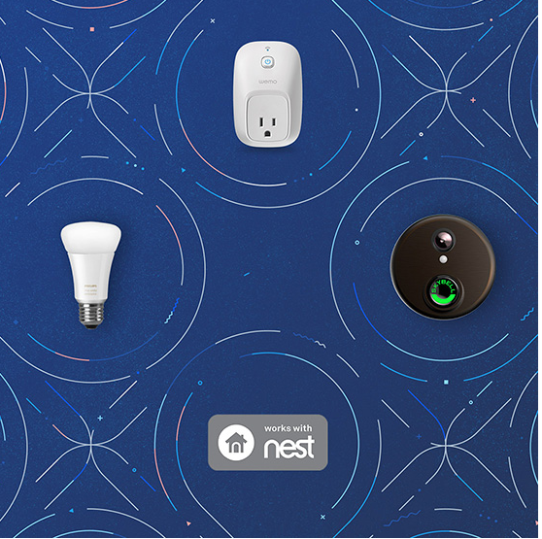
Data Sources
Mobile Phones:
GPS - Position
Android – Preferences
Accelerometer - Activity
Light Sensor - Environment
City Transport/Traffic Department Data
Meteorological Departments - Weather
Tariffs from Electricity Department Website
Bus, Train, Flight Schedules – Search Giant should know this!!!
Nest
Google acquired this ‘learning’ thermostat company in 2014 for $3.2 billion
And Many More…

Slide 9
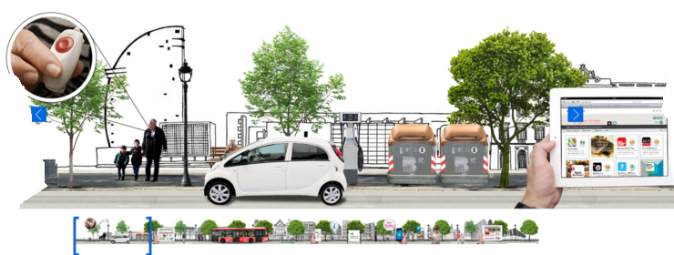
Nest is just one tiny component in this pervasive system of IoT

Slide 10
IoT – what is it ?
Internet of Things (IoT) is a new techno-commercial paradigm envisioned as a dynamic global network of IP-enabled objects, machines, devices, and appliances capable of interacting with each other via intranet/ extranet/Internet.
its popularity is governed by the value that it promises to create and the fast market growth
Ever since the term was introduced in the late 1990s, many solutions have been introduced to the IoT marketplace by different types of organizations
ranging from start-ups, academic institutions, government organizations and large enterprises

Slide 11
Do-it-yourself (DIY) prototyping platforms
They are cheaper and modular in nature
Arduino (arduino.cc) (and its variations such as Libelium (libelium.com)), .NET micro framework Gadgeteer (netmf.com/gadgeteer), LittleBits (littlebits.cc), etc.
They allow to test new ideas with limited budget/resources, and in less time.
Most of these products are open source in nature.
They can be programmed with common languages
C, C++, Python, C#, Java, Javascript, etc.
More importantly, over the last few years, they have become more interoperable with each other
this allow product designers to combine different prototyping platforms together

Slide 12
Small computer systems to support IoT prototyping
Raspberry Pi (www.raspberrypi.org)
single-board computer developed by Raspberry Pi Foundation of UK with the intention of promoting the teaching of basic computer science in schools.
However, more recently, Raspberry Pis are heavily used in IoT product prototype developments.
For example, IoT products such as NinjaBlocks (ninjablocks.com) have used Raspberry Pis in their production officially.
Importantly, most of the platforms such as Ardunio can successfully work with Raspberry Pi Computers.

Slide 13
Intel & Microsoft
Intel has produced a small computer (e.g., Intel Galileo and Intel Edison boards) which runs both Windows and Linux
competitive to Raspberry Pi
Intel Edison is a tiny computer offered by Intel as a development system for wearable devices.
Programming IDE tools such Microsoft Visual Studio provides significant support for IoT program development
by facilitating visual wiring, mash-ups and automated code generations.
Such ease of programming and prototyping capabilities have attracted significant attention from hobbyist, researcher, and even from school children.

Slide 14
IoT ecosystem

Slide 15
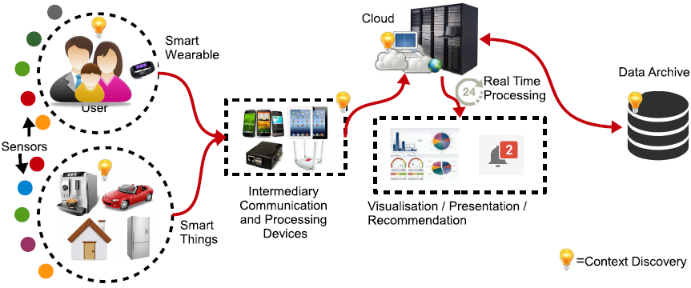
IoT ecosystem

Slide 16
Ecosystem components
Device manufacturers
Sensors/actuators, smart appliances
Network service providers
Operators, NMS providers
Cloud service providers
Data centres, dBase, dWarehouse
Platform providers
Middleware providers, SDKs
3rd party application developers
Analytics providers, tools, APIs
IoT
App

Slide 17
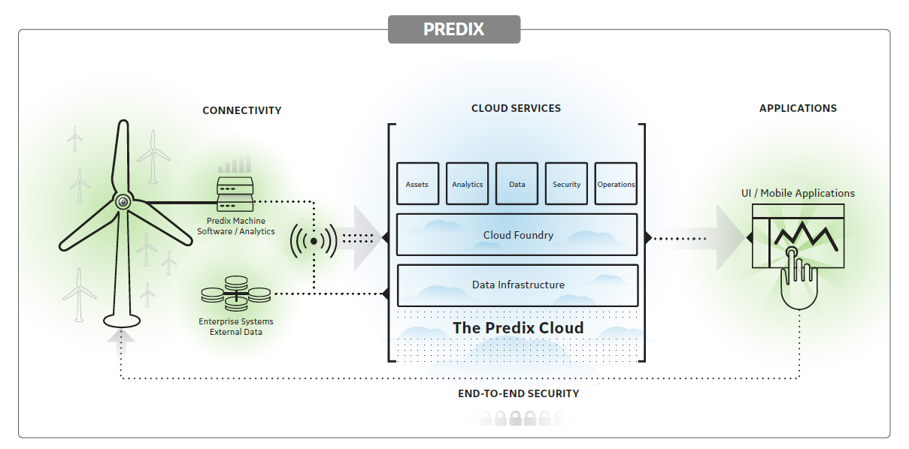
Example
General Electric (GE) deploys sensors in its jet engines, turbines, and wind farms. By analyzing data in real time, GE saves time and money associated with predictive maintenance.
IoT
App

Slide 18
Is IoT a new kid in the block ?
No, it’s just maturing over time.

Slide 19
IOT – Evolution
Pervasive Computing

Slide 20
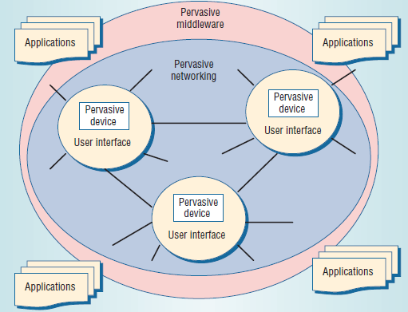
Which one is “IoT” here ?
IoT ≡ PerNet

Slide 21
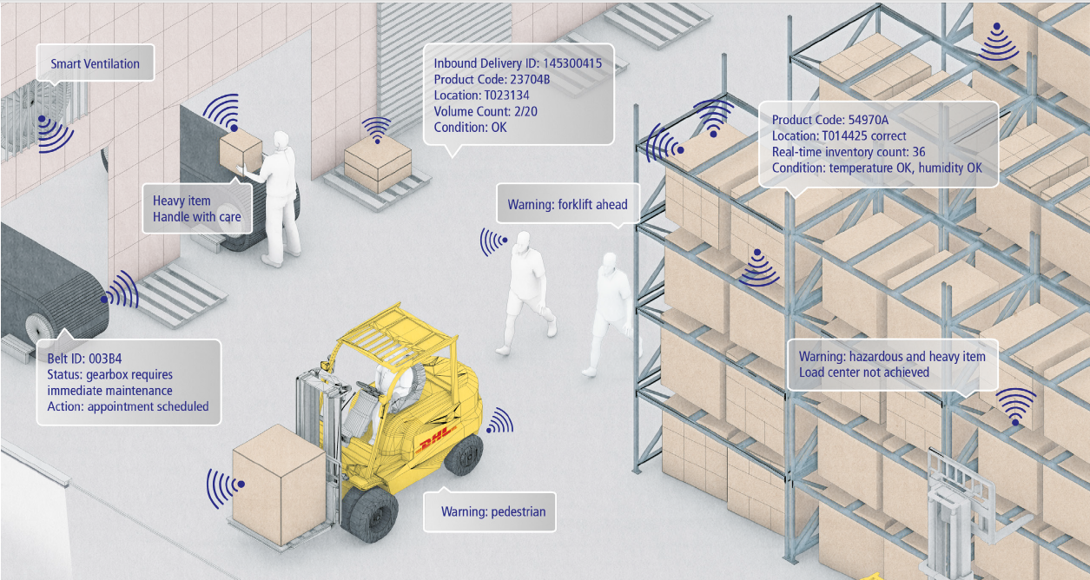
Let us consider one example
RFID is being extensively used in enterprises
Smart Warehouse

Slide 22
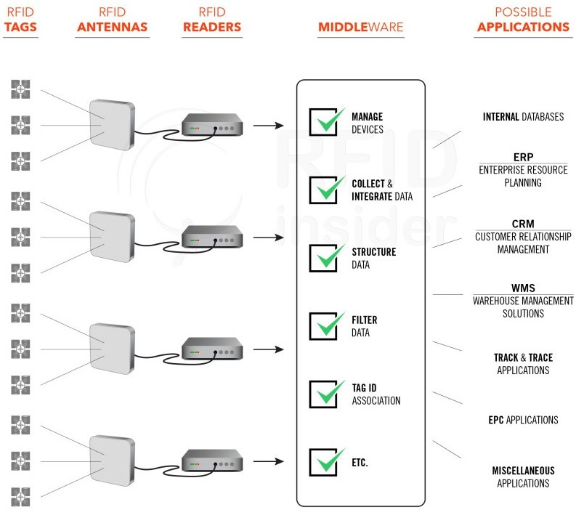
Pervasive
Network

Slide 23
IoT – enabler of “PerCom”
IoT ≡ Pervasive Network (PerNet)
It promises people and things to be connected any-time, anyplace, with anything and anyone, ideally using any path/network and any services.
Ref: “Pervasive Computing: A Paradigm for the 21st Century”, IEEE Computer Magazine, March 2003
It will create a better world for human beings
Because objects around us will know what we like, what we want, and what we need and act accordingly without explicit instructions.
Context-sensitiveness

Slide 24
Broad research directions

Slide 25
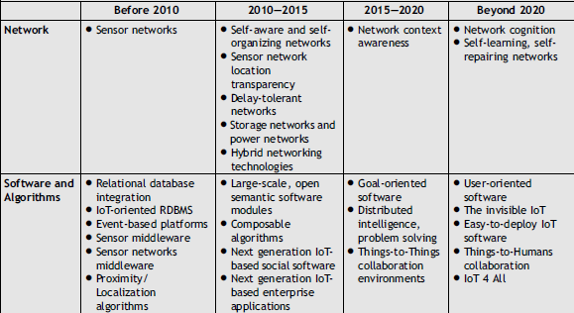
Research directions (contd.)

Slide 26
Imminent Challenges
Perception: Context awareness
Smartness: Context management
Scalability
Heterogeneity
Integration
Invisibility
Reference: D. Saha & A. Mukherjee, “Pervasive Computing: A Paradigm for the 21st Century”, IEEE Computer Magazine, March 2003.

Slide 27
In spite of having so many challenges, IoT has the potential to deliver Extraordinary Benefits
like Industry 4.0
Notes:
While these benefits can certainly inspire business owners, they can also be construed as largely academic … so let’s take a look at some real-world use cases, to show how IoT will benefit us in our daily lives …

Slide 28
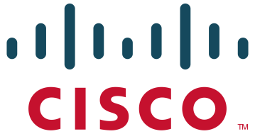
Three Waves of ICT
First wave of ICT
Automated Individual activities of value-chain
Standardization of processes
Second Wave of ICT
1980s & 90s
Rise of internet
Third wave of ICT
Starting 2000s
1960s & 70s
Integrated value chain
Smart, Connected Products
Reshaping Industry Boundaries
Notes:
IBM Mainframes – Applications
Connected products: three components – 1. Physical 2. Smart Components 3. Connectivity components

Slide 29
Web & Mobile are immensely successful
Pervasiveness
Pervasive ICT
(2020)
Cloud –based ICT
(2010)
Third Wave
Mobile
ICT
(2000)
Grid-based ICT
(1995)
Web-based ICT
(1990)
Second Wave
Distributed ICT
(1985)
Personal ICT
(1980)
Time

Slide 30
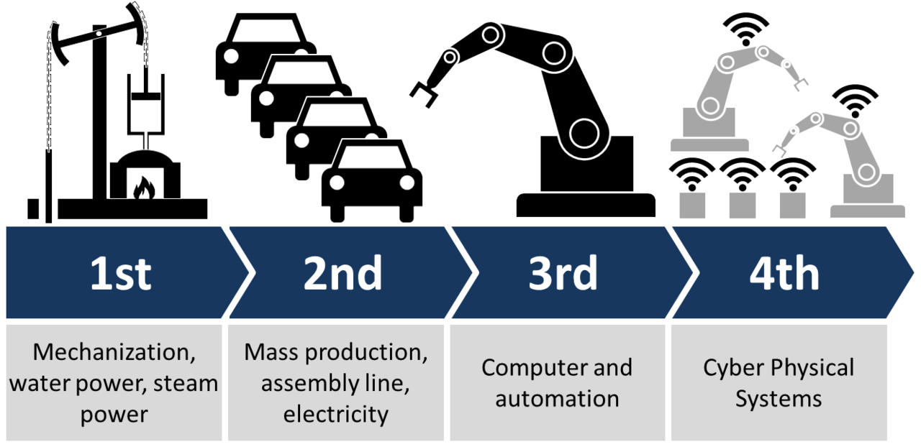
Industrial Revolutions
Here enters ICT
Here comes IoT

Slide 31
Let us watch the video
Disclaimer: This is NOT a promotional exercise; neither do we recommend the products/solutions from the company mentioned in the video

Slide 32
Cloud + IoT = CoT

Slide 33
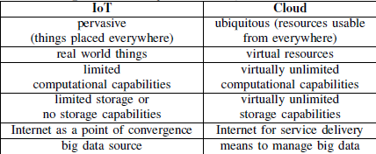
Complementarity between IoT and Cloud
Plus cloud provides –
Service-oriented abstractions for the complex underlying hardware and software through a set of services needed by different applications
Offer high flexibility when new and advanced functions need to be added
Services can be designed, implemented, and integrated in a flexible and easy way for new application development

Slide 34
Everything (X) as a Service (XaaS)
XaaS (acronym) | X | Description
TaaS | Things as a service | aggregating and abstracting heterogeneous resources according to tailored thing-like semantics
SNaaS or S²aaS | Sensing as a service | providing ubiquitous access to sensor data
SAaaS | Sensing and Actuation as a service | enabling automatic control logics implemented in the Cloud
SEaaS | Sensor Event as a service | dispatching messaging services triggered by sensor events
SENaaS | Sensor as a service | enabling ubiquitous management of remote sensors

Slide 35
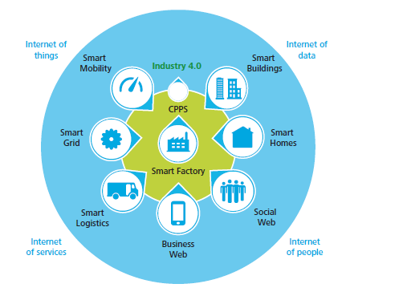
CoT = Internet of Everything (X) + XaaS

Slide 36
An interesting business trend

Slide 37
Sensing as a Service
In IoT, even the same data can be used to derive different insights in different application domains.
The ability to derive different insights by using same set of data validates the importance of “Sensing as a Service” model, which envisions to create a data market that buys and sells data.
Monetization of IoT data ????

Slide 38
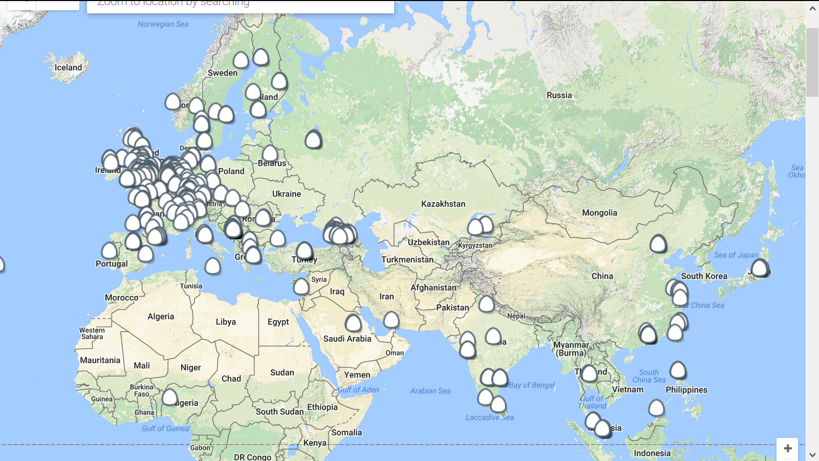
http://airqualityegg.com/

Slide 39
But the current configuration poses challenge

Slide 40
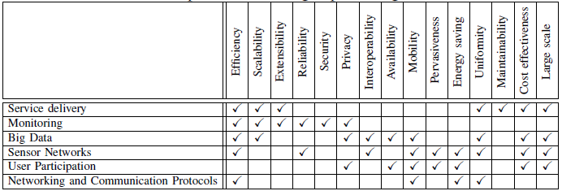
Challenges
But, arguably, the biggest issue is the position of cloud in IoT ecosystem

Slide 41
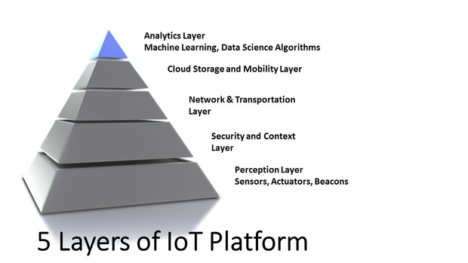
See how distant is the cloud layer from the perception layer

Slide 42
Effect on CoT

Slide 43
So we need edge computing
IoT World Forum has recognized it

Slide 45
Happenings in CoT
Support environments + Research projects + Tools

Slide 46
Platforms, services and research projects

Slide 47
Research projects
ClouT, a joint European-Japanese ICT project
http://clout-project.eu/
BigClouT after ClouT ended in June 2016
http://bigclout.eu
Distributed Research on Emerging Applications and Machines (DREAM) @ IISc, Bangalore
http://dream-lab.cds.iisc.ac.in/about/overview/
Smart CoT (SCoT) of Instt of Telecom, Portugal
https://www.it.pt/Projects/Index/2157
………

Slide 48
Support sites
Lab of Things (LoT) of Microsoft
http://www.lab-of-things.com/
Kaa – open and efficient Internet of Things cloud platform
https://www.kaaproject.org/
….

Slide 49
Company
Cloud of Things Ltd., 1st Floor, 45 Rothshild blvd., Tel-Aviv, 6578403, ISRAEL
https://www.cloudofthings.com/#solution
Cumulocity – independent IoT device and application management platform provider
https://www.cumulocity.com/news/
…….

Slide 50
Conclusion

Slide 51
“IoT-ification” + “Cloud-ification”
Today there is an ongoing hype to “IoT-fy everything” by embedding a sensor (that is connected to a network) in that thing
Cost of sensors has come down
Cost of processing is nominal
Wireless connectivity is easily available
How to manage so much IoT-ification really ?
Cloud is the only answer as of now

Slide 52
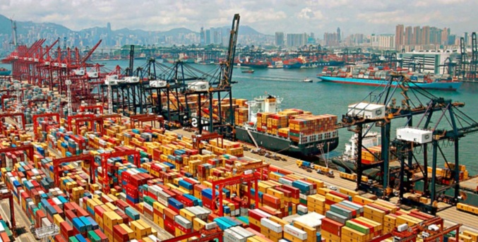
Use case challenge: Can it be found automatically?
If a container goes missing here

Slide 53
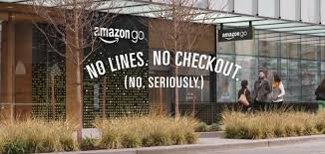
Amazon already implemented CoT using AWS and IoT …

Slide 54
Amazon go Check The Video https://www.youtube.com/watch?v=NrmMk1Myrxc

Slide 55
References
[1] https://sites.google.com/site/opensourceiotcloud/
[2] http://www.openiot.eu/
[3] http://iot-toolkit.com/
[4] http://postscapes.com/internet-of-things-cloud
[5] http://www.nimbits.com/
[6] http://www.iot-a.eu/
[7] https://xively.com/
[8] http://open.sen.se/
[9] https://thingspeak.com/
[10] http://www.netlabtoolkit.org/learning/tutorials/iot-cloud-services/
[11] http://clout-project.eu/home2/
[12] https://datatracker.ietf.org/wg/roll/charter/

Slide 56
Thank You For Your Patient Listening !

Slide 57
Questions please
For offline queries, write to me ds@iimcal.ac.in

