Slide 1
Reducing Peak Power Costs in Cloud Data Centers
Bhuvan Urgaonkar
Dept. of Comp. Sci. and Engg.
The Pennsylvania State University

Slide 2
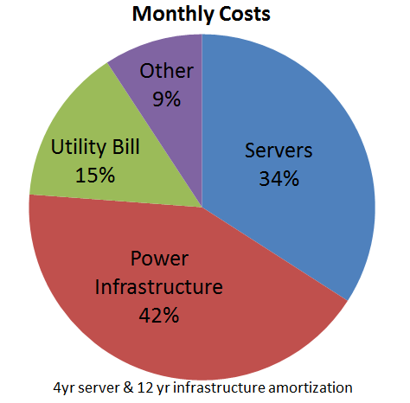
Monthly Costs for a Data Center
Assumptions:
10MW Tier-2 data center
20,000 servers
Ignore cooling
15$/W Cap-ex
Duke Energy Op-ex
4yr server recycling
12 yr power infra. recycling
Peak draw a significant reason for high power costs
All cost are normalized to a month
Notes:
For instance, if we look at the overall cost of a 10 MW datacenter and amortize it at a monthly granularity, the one-time cost of constructing the power infrastructure contributes to 37% of the overall cost, which is even lower than the utility bill
In this work, we focus on reducing this power infrastructure cost using a novel peak shaving solution based on energy stored in UPS batteries
What constitutes the power infrastructure cost?

Slide 3
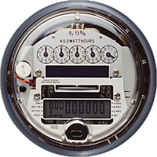
Peak Power Impact on Op-ex
15-min
Peak power draw
12 $/KW
Average
draw
Power draw (W)
Peak to
Average
ratio
3:1
Energy consumption
(area under this curve)
5 c/KWh
Month
Duke Utility Tariffs
(12 $/KW, 5 c/KWh)
Notes:
All of us must be familiar with the utility bill that we pay every month for our homes
Which is determined by the overall energy that we consume during that month
But when we look at utility bills of datacenters look very different
This is because, utility companies charge commercial customers like datacenters not just
for their energy consumption but also for their peak draw
Let me explain what utility companies mean by peak draw
Utility companies use separate meters to record the energy consumed during 15 minute time scales
And at the end of the month, take the maximum energy consumption across these 15 minute durations and call that as the peak draw and charge separately for this draw
That is, even if a power spike occurred during one single 15 min interval during the month, it still contributes to my bill
But what is the significance of this peak component to overall bill
If I consider the duke energy utility charges which 5c/KWh of the energy consumption and 12$/KW for the peak draw
(and it is similar for other utility companies)
For a power profile like this with tall peak, where peak is about 3 times the average, peak draw can contribute to
as much as 50% of my bill.
This suggests that peak draw is equally important to optimize as the energy component
Is peak a problem only for tall peaks?

Slide 4
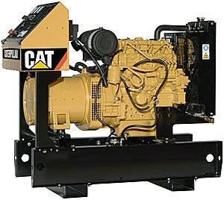
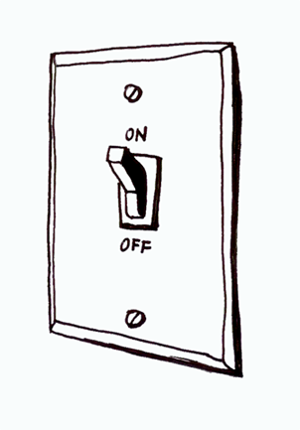
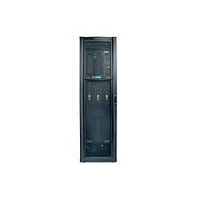
Data Center Power Infrastructure
Power
Infrastructure
Utility
Substation
Diesel Generator
(DG)
Auto Transfer
Switch (ATS)
UPS
Battery
Power
Distribution
Unit (PDU)
…
Server
Racks
…
Notes:
4
4
Utility power enters the datacenter through the utility substations. Datacenters also employ secondary power source Diesel Generators to handle utility black outs/brown outs. Since Diesel Gens take 10-15s to start up after an utility outage, UPS batteries are used to source power for this short duration. Datacenters also have power dist. Units (PDUs) which are transformers for lowering voltage required for servers. All these electrical equipment from the substation to the PDUs constitute the power infrastructure.

Slide 5
Expensive Equipment …
Utility
Substation
Diesel Generator
~2 $/W
UPS
~1-2 $/W
(centralized more costly)
Power Distribution Unit (PDU)
~0.3 $/W
…
Notes:
5
5
These high wattage electrical equipment are very expensive and the cost is mostly dependent on the peak capacity supported by these equipment.
How is the peak capacity determined?

Slide 6
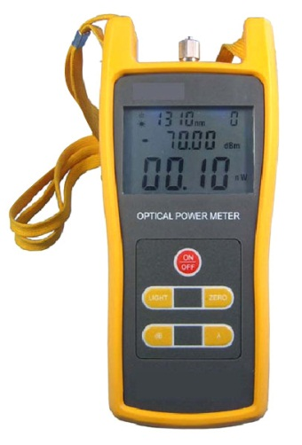
… Provisioned For (Rare) Peaks …
Rare Peaks
Rated Peak
capacity
Utility
Substation
Power (W)
Time
Diesel Generator
(DG)
UPS
Battery
Power
Distribution
Unit (PDU)
…
Notes:
6
6
Equipment capacity is determined by the workload peak power demand estimated – even if these peaks are rare events
Circuit breakers are employed at all levels of the datacenter to protect these costly equipment from overdraw

Slide 7
Key Lesson: Try to Reduce the “Size” of Power Infrastructure
Notes:
We all know that datacenters have become heavy power consumers
In fact, if datacenters were treated as a country, they would rank 5th in the world for their electricity usage
This has in turn translated in to heavy power related cost for datacenters

Slide 8
Under-provisioning
Notes:
We all know that datacenters have become heavy power consumers
In fact, if datacenters were treated as a country, they would rank 5th in the world for their electricity usage
This has in turn translated in to heavy power related cost for datacenters

Slide 9
Overbooking w/ Stat. Mux.
Notes:
We all know that datacenters have become heavy power consumers
In fact, if datacenters were treated as a country, they would rank 5th in the world for their electricity usage
This has in turn translated in to heavy power related cost for datacenters

Slide 10
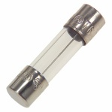
Under-provisioned Power Infrastructure
Rated Peak
capacity
Utility
Substation
Power (W)
Cost
Savings
Time
Diesel Generator
(DG)
UPS
Battery
Under-provisioning
Ranganathan et al., Barroso et al.,
Bhandarkar,
Hamilton.
Power
Distribution
Unit (PDU)
…
Notes:
10
10
Underprovisioning allows the equipment capacity to be lower than the workload peak – technique used to lower datacenter cap-ex cost

Slide 11
Under-provisioned Power Infrastructure
Emergency
Rated Peak
capacity
Utility
Substation
Power (W)
Time
How to deal with emergencies?
Diesel Generator
(DG)
UPS
Battery
Power
Distribution
Unit (PDU)
…
Notes:
11
11
But underprovisioning leads to scenarios where datacenter operate in unsafe regions – above equipment rated capacity – which we call as emergency
How do we deal with such emergency scenarios?

Slide 12
Emergency Handling Knobs
1. DVFS Throttling
(Modulate processor voltage/frequency)
Underprovisioned
Power Cap
Power (W)
Apply knob
Time
Voltage/Frequency
Server cluster
Notes:
For instance, if we look at the power consumption of a server cluster over time, the underprovisioned power cap is shown here, now, we want to periodically monitor power draw and use some knob to lower the power draw to operate below the power cap. One popular knob for achieving this is dynamic voltage and frequency scaling

Slide 13
Emergency Handling Knobs
1. DVFS Throttling
(Modulate processor voltage/frequency)
Power Cap
Power (W)
Fan et al., [2007], Felter et al., [2005], Frank et al., [2002], Meisner et al., [2011], Ranganathan et al., [2006]
Time
Voltage/Frequency
Notes:
Which lowers the processor voltage and frequency to operate below the power cap. This is a fast and easy to use knob.. But may impact application performance as studied in literature..

Slide 14
Emergency Handling Knobs
2. Local migration
(load concentration)
Power Cap
Power (W)
Chase et al., [2001],
Pinheiro et al., [2001],
Lim et al., [2011],
Verma et al., [2010]
Time
Load
migration
Server cluster
+
+
Server
Shutdown
Notes:
Another knob for lower power draw is migrating load on to fewer number of servers and shutdown those unused servers – here reaction to power emergencies might be slow due to load redirection/migration and may also impact performance

Slide 15
Emergency Handling Knobs
3. Remote migration
(spatial peak shift)
Power Cap
Power (W)
All these knobs may degrade performance
Moore et al., [2005], Chase et al., [2001],
Pinheiro et al., [2001], Verma et al., [2010]
Ganesh et al., [2009], Lin et al., [2011]
Time
Migrate to a remote cluster
Server cluster
Notes:
There might be scenarios where certain parts of the datacenter power infrastructure is overloaded – say few transformers are operating close to their peak capacity – in this case, we can offload workload to other parts of the datacenter with enough power slack or even to a different datacenter locations.. This can be achieved using live migration technique which migrates application state without impact its availability.. Reaction time to emergencies might be slow and may impact application performance.. All the techniques that we have seen so far impacts performance.. Is there a way to handle power emergencies without performance impact?

Slide 16
A “Perf.-Friendly” Knob: Energy Storage
Agile knob
No performance Impact
New
draw
Power Cap
How to realize energy storage in a data center?
Power consumption (W)
Energy Storage
Device
Time
Notes:
16
We propose a new knob based on stored energy in UPS batteries to achieve this..
If I consider this power profile where the peak is generally drawn from utility power lines,
And we may want to underprovision peak draw to a lower limit indicated as ‘power cap’
We propose to use an energy storage device to achieve this power cap
The idea is to store energy in the device when the power draw is lower than the cap
And when the power draw exceeds the cap, instead of drawing the entire peak from the power line, the energy
Storage device can be used to supplement the power infrastructure for handling the draw above the cap
Using this technique, the power draw from infrastructure can be reduced and hence their peak capacity
One key benefit of this compared to conventional knobs is that, it is totally transparent to the applications,
Since applications enjoy their full power needs and the peak power is only hidden from the power lines
if we want to use this knob for peak reduction, where do datacenters get such energy storage devices?
One option is to provision separate energy storage devices in datacenters.
But in this work, we try to use the existing storage device in the form of UPS batteries for reducing peak draw.

Slide 17
Energy Storage in Current Data Centers
Utility
Substation
Diesel Generator
(DG)
Auto Transfer
Switch (ATS)
Cost Saving
UPS
Power
Distribution
Unit (PDU)
…
Server
Racks
…
Notes:
17
17
If you look at today’s datacenters, there is already an ESD which is an ups unit, and the purpos of this device, not for demand response purpose for seamless transition from here to here, when this fails. However, if we use ESD for dr, all the power hiearchies above Ups may see a smoother profile and hence has cost savings for all the components above, then why should we restrict at datacenter level, we may want to push it further down.
There are already energy storage devices- in the form of UPS units- in current datacenters. However, they have been primarily used as a back-up mechanism to temporarily handle power outrages until diesel generators are brought on-line. This typically takes a few seconds and most datacenters provision UPS devices with lead-acid batteries of 2X-3X this capacity to tolerate things like back-to-back utility failure.
Our prior work has shown the benefit of using such centralized lead-acid based battery for demand response purpose.

Slide 18
Distributed UPS Configurations
Rack level UPS
Server level UPS
Utility
Substation
Utility
Substation
Can existing UPS be used like this?
Diesel Generator
(DG)
Diesel Generator
(DG)
Auto Transfer
Switch (ATS)
Auto Transfer
Switch (ATS)
Invest in additional energy storage?
PDU
…
…
ESD
Cost
Saving
…
Server
Racks
…
Similar to the ones in Google, Microsoft and Facebook data centers
Notes:
18
18
Get smoothed out right from the lowest level, which means that the power
This brings me to the two main problems:
First, as I will show later, there are actually benefits of doing that.
Second, As I will show later,
Newer high-density datacenters are being built with distributed ESDs, e.g., server-level UPS units in Google, rack level units in Facebook and Microsoft. The primary motivation for such decentralization is to reduce energy losses due to AC and DC double conversion. In all these cases, the ESD whether at a server or at a rack, is still used only for handling power outages. While recent research has also shown the benefits of lead-acid battery based UPS for datacenter DR – whether it be in shaving peaks to under-provision the power infrastructure or for shifting demand away from high tariff periods. All such prior work has only considered a single type of ESD, placed at a single location in the datacenter power hierarchy. However, with a plethora of ESD options available today, why should we constrain ourselves to any single ESD technology? And since workloads show different temporal and spatial variations across different levels of hierarchy, why should we restrict ESDs to any one level of the datacenter power hierarchy?

Slide 19
Can Existing UPS Be Used?
Cost-Benefit Feasibility
Would batteries pay for themselves?
Energy Loss (charge/discharge)
Battery Health and Lifetime
Reliability
What happens to overall power infra. availability?
Notes:
Before we try to answer these questions, we need to understand the feasibility concerns related to using UPS batteries

Slide 20
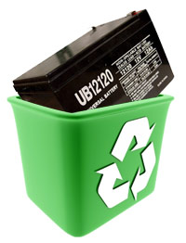
Battery Health
Battery Health
Frequency of charges and discharges
Depth of discharge
Notes:
In general batteries last only for finite number of charge/discharges operations
For instance, even our laptop and phone batteries last only for few hundred charge/discharge operations before they become unusable and require to be replaced
(not needed) This is because, every discharge reduces the ability of the battery to retain its full capacity
Not only that, the extent to which we drain the battery everytime we use it also impacts its lifetime
Lets me use an example to make it more clear
20

Slide 21
Battery Health
Power
Cap
Power (W)
Shallow
discharge
1 Day
Power
Cap
Power (W)
Deep
discharge
1 Day
Notes:
21

Slide 22
Battery Health
Day1
Year 1
Year 3
Power
Cap
Power (W)
…
…
Shallow
discharge
Time
Day1
Year 1
Dead
Power
Cap
Power (W)
…
Deep
discharge
Time
Notes:
The datacenter trying to shave a bigger peak may
22

Slide 23
Battery Health
Lead-acid Battery Lifetime Chart charge/discharges sustained before requiring replacement
How to keep battery alive for 4 years?
Deeper Discharges
= Quicker Death
Notes:
What is the consequence of this behavior to eBuff design?
When using eBuff for peak reduction, we do not want the batteries to die sooner than what it is generally expected to last
Typically, lead-acid batteries used in datacenters have a refresh cycle of about 4 years
Is it possible to use eBuff while at the same time make the batteries last for 4 years?
23

Slide 24
Battery Health
Battery operational rules
(4 year lifetime constraint)
Restrict battery usage to meet lifetime constraint
20% of peak load
can be sourced from
UPS for 2.5 hours
every day
Notes:
To answer this question, we use the data from battery runtime/lifetime charts and derive battery operational rules to make it last for 4 years and the result from our analysis is shown in this chart
Lets look at one point in the curve to understand the operational rules,
If we want to sourve 20% of battery capacity, we can do so for at most 2 and half hours a day, beyond which it would compromize on the lifetime
And this duration can be drawn in multiple charge/discharges as long as none of the discharges exceed the depth of discharge of 40%
24

Slide 25
Can we still handle Utility Outages?
Utility
substation
10-20s
startup delay
Default
handling
of outages
Diesel Generator
UPS
battery
…
…
Notes:
25
25
The final concern that we address is related to the ability of battery to handle power outages..
Usually UPS will be fully charged since discharged only during power outages
But eBuff usage may leave less battery charge and thus may compromize availability

Slide 26
Can we still handle Utility Outages?
10-20s
startup delay
Outages with
UPS-based demand response
Utility
substation
What should UPS residual capacity be for desired availability?
Power Unavailability: {Utility Failure} AND {DG failure/delay} AND {Battery Out of Charge}
Diesel Generator
UPS
battery
…
…
Notes:
26
26
Usually UPS will be fully charged since discharged only during power outages
But eBuff usage may leave less battery charge and thus may compromize availability

Slide 27
Can we still handle Utility Outages?
Continuous-time Markov model
Battery capacity
DG transition time
Failure/Recovery rates
Utility
substation
Always leave 2 minutes of reserve capacity in battery
10-20s
startup delay
Residual Battery Capacity | Data center Power Availability
2 Minutes | 0.9999977
5 Minutes | 0.9999990
10 Minutes | 0.9999994
Diesel Generator
UPS
battery
…
…
Notes:
27
27

Slide 28
Invest in Additional Battery Capacity?
Infrastructure Cost $/W for IT
Battery
Cost
Emergency duration
1 $/W | 2 $/W | 5 $/W | 10 $/W | 15 $/W
12.3 | 25.7 | 65.7 | 132.3 | 199
5.7 | 12.3 | 32.3 | 65.7 | 99
2.3 | 5.7 | 15.7 | 32.3 | 49
-0.2 | 0.7 | 3.2 | 7.3 | 12
1.7 | 4.3 | 12.3 | 25.7 | 39
0.3 | 1.7 | 5.7 | 12.3 | 19
-0.3 | 0.3 | 2.3 | 5.7 | 9
-0.8 | -0.7 | -0.2 | 0.7 | 1.5
Return On Investment (ROI)
15 mins
30 mins
1 hour
4 hours
15 mins
30 mins
1 hour
4 hours
100
$/KWh
500
$/KWh
Notes:
start with one point
100$/KWh and 30 mins..
Within 4 months we can recover the amount

Slide 29
Invest in Additional Battery Capacity?
Infrastructure Cost $/W for IT
Battery
Cost
Emergency duration
1 $/W | 2 $/W | 5 $/W | 10 $/W | 15 $/W
12.3 | 25.7 | 65.7 | 132.3 | 199
5.7 | 12.3 | 32.3 | 65.7 | 99
2.3 | 5.7 | 15.7 | 32.3 | 49
-0.2 | 0.7 | 3.2 | 7.3 | 12
1.7 | 4.3 | 12.3 | 25.7 | 39
0.3 | 1.7 | 5.7 | 12.3 | 19
-0.3 | 0.3 | 2.3 | 5.7 | 9
-0.8 | -0.7 | -0.2 | 0.7 | 1.5
Return On Investment (ROI)
15 mins
30 mins
1 hour
4 hours
15 mins
30 mins
1 hour
4 hours
100
$/KWh
500
$/KWh
Notes:
start with one point
100$/KWh and 30 mins..
Within 4 months we can recover the amount

Slide 30
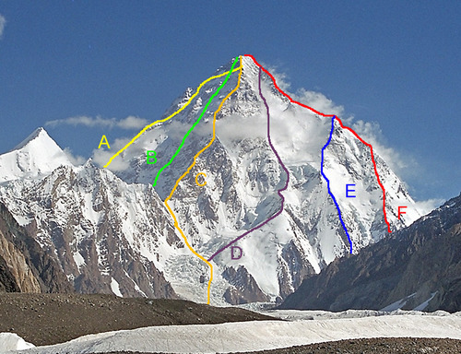
Which ESD to choose?
Power
Power
Power
E
E
Time
Time
E
Time
Notes:
The first point I’d like to make is that the efficacy of ESD tech is intimately tied to certain properties of the workload power properties.
Note that your workload can have different kind of power profiles, here are three examples show how the same total energy a datacenter consumes can have different kinds of power profiles. Here is very smooth and here is very bursty. Note that this is very analogous to this example I have here. Where the goal is to climb this mountain. So how can I climb this mountain? The work that needs to be done to climb this mountain is equavalent to the area under the curve. But how I climb represents the kind of power that I would expect to achieve this amount of work. (so the same energy can lead to different power profiles, just like climbing a moutain with different routes. )
Let me give you an analogy of climbing an mountain. Suppose we want to reach the top from the bottom of the mountain. There are many different ways - straight up - winding road - or combination. Though all with the same height,
- each has a different cost, in terms of equipment, energy, distance and so on.
Analogously, there are multiple peaks - tall narrow, wide peak for an ESD to shave. Suppose the area under these curve are the same which means they require the same energy from ESDs.

Slide 31
Which ESD to choose for peak shaving?
power
Time
Notes:
You may which creating a lot of peak power, or you can take a easier trail which does not require much power.
You may choose the straight up way which requires more effort but that is the shortest way and may take less time,
Similarly, to shave a tall and bursty peaks, an ESD with high power density is required but may need less energy for a single peak if it can be recharged very fast.

Slide 32
Which ESD to choose for peak shaving?
power
power
Time
Time
Notes:
You may also choose the winding way, it may takes less effort but may take longer time to reach the top.
Similarly, to shape peaks which are wide and short, it may not require much power but may need to hold energy for a long period

Slide 33
Ragone Plot
10,000
0
Compressed Air (CAES)
Specific Energy (Wh/kg)
1,000
Fuel Cell
Combustion Engine,
Gas Turbine
100
LI
Flywheels (FW)
Batteries
10
LA
1
Specific Power (W/kg)
Ultracapacitors
(UC)
Supercapacitors
0.1
Capacitors
10 100 1,000 10,000 100,000 1,000,000
Notes:
A broad spectrum of energy storage options exists, as is typically depicted using Ragone plots. A Ragone plot compares different ESD technologies in terms of their power densities and energy densities, where density can be either volumetric or mass based. There are sharp differences between various ESDs. For instances, CAES which compresses air in confined space and this pressurized air can subsequently be used to drive turbines for electricity generation. CAES may require significant real-estate to create such confined spaces. We use CAES as representative of the upper left end of the Ragone plot. CAES has a relatively high specific energy but a low specific power, implying that it is better suited for holding a large amount of energy as long as this energy does not need to be discharged very fast.
On the end hand, Ultracapacitors have high power densities, albeit they are unable to sustain a large power draw for an extended period of time. We use this ESD as representative of the lower right end of Ragone plot.
In the middle region, flywheels, the momentum of a rotating wheel/cylinder is gaining acceptance as a UPS device for datacenters to temporarily handle the load until diesel generators kick in. Even though they are not intended for extended operation, they can provide the high power needs .
Batteries are the most commonly used storage devices in datacenters where the electrochemical reactions of the appropriate chemistry within is used to store and generate electricity. There are several kinds of batteries and we will consider lead-acid and lithium-ion which are more prevalent and representative of two ends of battery spectrum on the Ragone plot with very different costs.
Now let’s look at some relevant parameters for these technologies

Slide 34
Ragone Plot
10,000
0
Specific Energy (Wh/kg)
Compressed Air (CAES)
1,000
100
LI
Flywheels (FW)
10
LA
1
Specific Power (W/kg)
Ultracapacitors
(UC)
Supercapacitors
0.1
10 100 1,000 10,000 100,000 1,000,000
Notes:
We consider some of these technologies in this work to represent different regions of ragone plot.
We identify 7 mwhich are important for the decision of selecting of ESD technologies

Slide 35
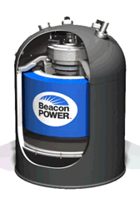
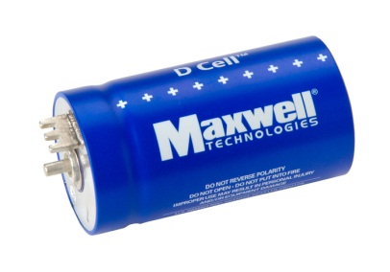
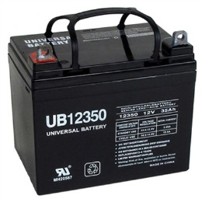
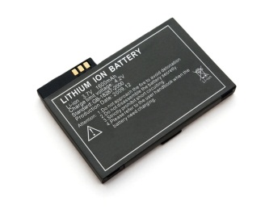
#1: Capital Cost (Energy and Power)
Ultracapacitor
Flywheel
Lithium ion battery
Lead-acid battery
Compressed air
Energy Cost ($/kWh) _{k} | 10,000 | 5,000 | 525 | 200 | 50
Power Cost ($/kW) | 100 | 250 | 175 | 125 | 600
Notes:
When optimizing electricity costs with ESDs, we need to account for the costs of ESD themselves. The cost of ESD depends on 2 factors – the total energy that is to be stored/discharged, and the rate (power) at which the energy is to be charged/discharged. As can be expected, from the energy point of view, CAES is the least expensive with ultracapacitors at the other end of the spectrum at 200X this cost. On the end , with respect to power, ultracapacitors are the most attractive option with CAES being 6X more expensive. Batteries offer a good compromise between these extremes.

Slide 36
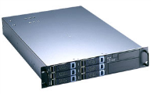
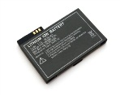
#2: Volume Density (Energy and Power)
Ultracapacitor
Flywheel
Lithium ion battery
Lead-acid battery
Compressed air
Energy Density (Wh/L) | 30 | 80 | 150 | 80 | 6
Power Density (W/L) | 3000 | 1600 | 450 | 128 | 0.5
Notes:
Beyond cost, it is also important to consider the densities of these technologies required to provide a certain energy and power demand. Density determines the volume / real-estate that needs to be provisioned in the datacenter to sustain the demands. Since datacenter real-estate is very precious – whether it be rack space or floor space, volume constraints may need to be imposed when provisioning ESDs. ESDs which may be attractive based on energy or power costs may not necessarily be suitable because of space constraints. For instance, CAES – the most cost-attractive option – is worst from the density viewpoint. At best, we can consider CAES at a datacenter scale where basements, sealed tanks in parking lots, etc, may be options.

Slide 37
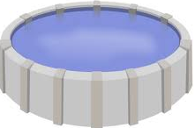
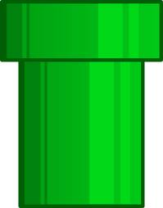
#3: Discharge Time vs. Charge Time
Peak cap
Peak cap
Power
Power
Time
Time
Flywheel
Compressed air
Lithium ion battery
Lead-acid battery
Ultracapacitor
Notes:
Since ESDs alternate between charging and discharging, it is important that there be sufficient charging time to hoard the required capacity before the next discharge. It typically takes longer to charge than discharge for many ESDs. Ultracapacitor and flywheels are fast in terms of charging while batteries particularly LA are not as attractive.

Slide 38
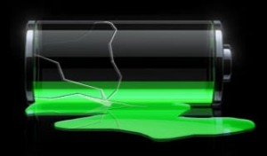
#5: Energy Efficiency
Energy Wastage
Input > Output
Flywheel
Ultracapacitor
Lithium ion battery
Lead-acid battery
Compressed air
Energy Efficiency (%) | 95 | 95 | 85 | 75 | 68
Notes:
The energy used to charge an ESD is higher than what can be drawn out subsequently, implying losses. Ultracapacitors and flywheels are very energy efficient while batteries can incur 15-25% based on their chemistries. The efficiency of CAES is even worse.

Slide 39
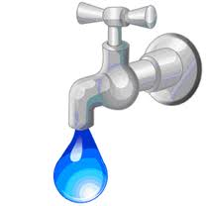
#6: Self-Discharge Losses
Lose charge even not being discharged
Flywheel
Ultracapacitor
Lead-acid battery
Lithium ion battery
Compressed air
Self-discharge per day | 100% | 20% | 0.3% | 0.1% | low
Notes:
ESD can lose charge even when they are not being discharged, with the loss proportional to the time since the last charge. Flywheels and ultracapacitors are poor from this perspective. Consequently, it may be desirable that such devices be charged just before a discharge, rather than hoarding the charge for a long time.

Slide 40
#7: Ramp Time
Power output
Start up time to change the power output
Time
Ramp time
Flywheel
Ultracapacitor
Lead-acid battery
Lithium ion battery
Compressed air
Ramp Time | Millisec | Millisec | Millisec | Millisec | Min
40
Notes:
Ramp rate refers to how fast charge/discharge power can change. Analogous to how combustion engines of automobiles can accelerate from zero to a given speed in a certain amount of time, and then sustain it at that speed. In most ESDs, the ramp rate is very high, taking only a few milliseconds to start supplying required power draw except in CAES where it can take several minutes. So for CAES either i) anticipating the draw and taking pro-active measures, or ii) using some other ESD until CAES becomes to ready to sustain the draw.

Slide 41
Given a workload, which ESD is best suited for reducing its peak?
Notes:
Considering all these ESD properties,

Slide 42
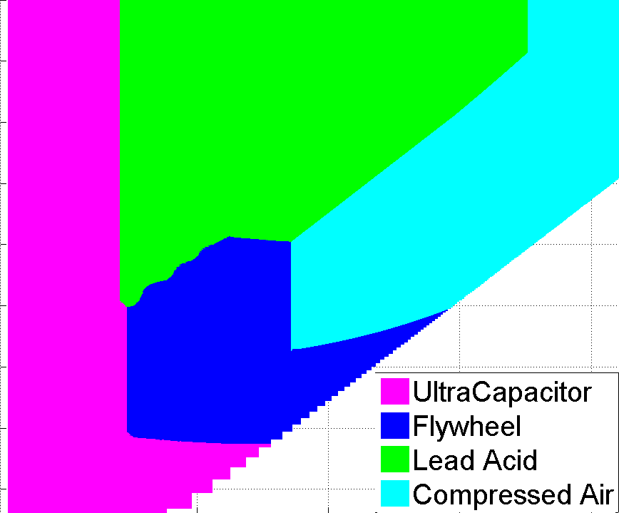
No Single ESD Best for all Peaks
32
8
Inter-peak distance: D (hour)
2
D
Peak cap
0.5
Power
UltraCapacitor
Flywheel
Lead Acid
CAES
Time
0.1
W
1 10 100
Peak Width: W (min)
Notes:
Animate it with lord of ring (google)
So far, we have only looked at ESD properties and their tradeoffs. To achieve effective selection and placement of ESDs in the datacenter, it is important to understand the efficacy of each ESD technology in shaping a given power demand series. By using some back-of-envelope calculations, we show the most cost-effective options for different demand regions.
As can be seen, for each ESD technology, there is a portion of the workload region, where it is cost-superior to other technologies. For example, ultracapacitors is best when we have extremely narrow peaks. This is because ultracapacitors offer the cheapest cost/power draw and they can be recharged fast enough within high frequency of peak occurrence. Although they are the most expensive in terms of cost/unit energy, this does not become prohibitive since the peaks to be shaved for these demands require only small amounts of energy.
At the other end, CAES is an attractive option for wide peaks. Flywheels and batteries are better options for power demand in the middle regions.

Slide 43
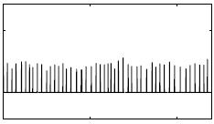
No Single ESD Best for all Peaks
32
8
UC
Inter-peak distance: D (hour)
Power
2
UC
Time
0.5
UltraCapacitor
Flywheel
Lead Acid
CAES
0.1
1 10 100
Peak Width: W (min)
Notes:
So far, we have only looked at ESD properties and their tradeoffs. To achieve effective selection and placement of ESDs in the datacenter, it is important to understand the efficacy of each ESD technology in shaping a given power demand series. By using some back-of-envelope calculations, we show the most cost-effective options for different demand regions.
As can be seen, for each ESD technology, there is a portion of the workload region, where it is cost-superior to other technologies. For example, ultracapacitors is best when we have extremely narrow peaks. This is because ultracapacitors offer the cheapest cost/power draw and they can be recharged fast enough within high frequency of peak occurrence. Although they are the most expensive in terms of cost/unit energy, this does not become prohibitive since the peaks to be shaved for these demands require only small amounts of energy.
At the other end, CAES is an attractive option for wide peaks. Flywheels and batteries are better options for power demand in the middle regions.

Slide 44
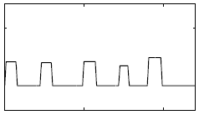
No Single ESD Best for all Peaks
Ultracapacitor
32
Power
Time
8
CAES
2
CAES
Inter-peak distance(hour)
Power
0.5
UltraCapacitor
Flywheel
Lead Acid
CAES
Time
0.1
1 10 100
Peak Width (min)
Notes:
So far, we have only looked at ESD properties and their tradeoffs. To achieve effective selection and placement of ESDs in the datacenter, it is important to understand the efficacy of each ESD technology in shaping a given power demand series. By using some back-of-envelope calculations, we show the most cost-effective options for different demand regions.
As can be seen, for each ESD technology, there is a portion of the workload region, where it is cost-superior to other technologies. For example, ultracapacitors is best when we have extremely narrow peaks. This is because ultracapacitors offer the cheapest cost/power draw and they can be recharged fast enough within high frequency of peak occurrence. Although they are the most expensive in terms of cost/unit energy, this does not become prohibitive since the peaks to be shaved for these demands require only small amounts of energy.
At the other end, CAES is an attractive option for wide peaks. Flywheels and batteries are better options for power demand in the middle regions.

Slide 45
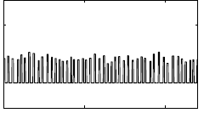
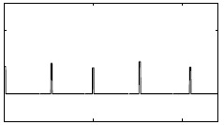
No Single ESD Best for all Peaks
Ultracapacitor
32
Power
Time (W=1min)
LA
8
CAES
Power
2
Time (W=100min)
Inter-peak distance(hour)
FW
Power
FW
0.5
UltraCapacitor
Flywheel
Lead Acid
CAES
Time (W=10min, D=0.5h)
LA
0.1
Power
1 10 100
Peak Width (min)
Time(W=10min, D=5h)
Notes:
So far, we have only looked at ESD properties and their tradeoffs. To achieve effective selection and placement of ESDs in the datacenter, it is important to understand the efficacy of each ESD technology in shaping a given power demand series. By using some back-of-envelope calculations, we show the most cost-effective options for different demand regions.
As can be seen, for each ESD technology, there is a portion of the workload region, where it is cost-superior to other technologies. For example, ultracapacitors is best when we have extremely narrow peaks. This is because ultracapacitors offer the cheapest cost/power draw and they can be recharged fast enough within high frequency of peak occurrence. Although they are the most expensive in terms of cost/unit energy, this does not become prohibitive since the peaks to be shaved for these demands require only small amounts of energy.
At the other end, CAES is an attractive option for wide peaks. Flywheels and batteries are better options for power demand in the middle regions.

Slide 46
Hybrid ESD solution may be desirable
Battery
Compressed
Air
Ultracapacitor/flywheel
Power
Time
Notes:
Therefore, when a datacenter may house different kinds of workloads – either across its different spatial regions or temporally over its lifetime – it may be worthwhile to consider hybrid ESD options.

Slide 47
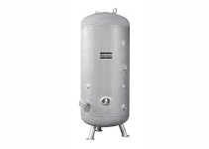
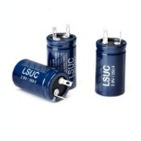
Multi-level Multi-technology ESDs
Diesel Generator
Utility
Battery
ATS
Flywheel
Compressed
Air
ESD
…
PDU
PDU
PDU
Battery
ESD
ESD
ESD
…
Capacitor
…
…
…
ESD
Server
H/W
Rack
Rack
Rack
Notes:
Within a datacenter, the nature of the power demand seen at different levels of its power hierarchy can be different, e.g., higher averages and smaller variances because of statistical multiplexing effects as we move up.
We find different technologies being the most cost-effective when comparing power demand with different average and variances. Besides, space constraints are different across different levels. Therefore, it may be desirable to employ appropriate ESD technologies at multiple –server, rack, and datacenter levels of the power hierarchy. Furthermore, pushing ESDs deeper down the hierarchy can allow higher cape savings.

Slide 48
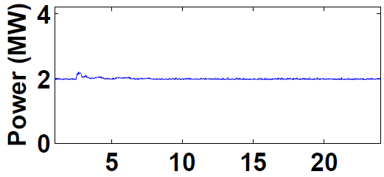
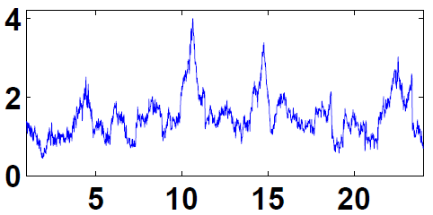
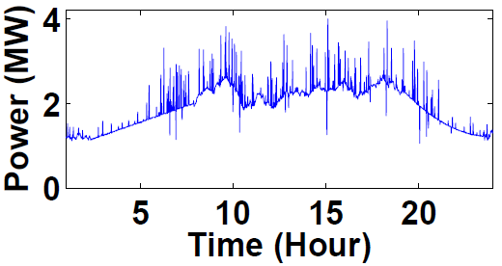
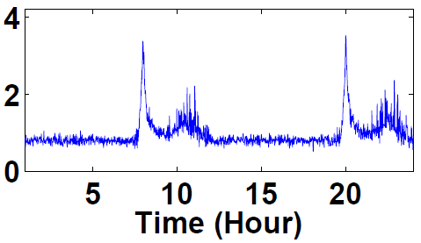
Realistic Power Profiles
(a) TCS (Indian IT Company)
(b) Google
(c) MSN
(d) Streaming Media
Notes:
We consider a variety of realistic power demand profiles. Some with little peak while some have a variety of peaks and variations. And we consider a 4MW datacenter, so the power profiles are normalized to this value.
We consider power demands of real-world datacenters and clusters with different types of peak demands. E.g., TCS has an extremely small peak (we found that net savings offered by any ESD is small 2%) but sill off-setting the cost of ESD provisioning. While for Google, MSN and stream media, show large peaks and variations. And we select two of them to present our results.

Slide 49
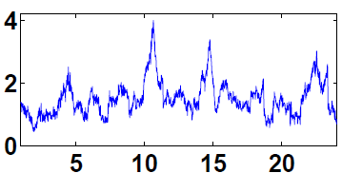
Cost Savings for Google Workloads
(Savings, ESD cost)
Datacenter:
FW+CAES
Server: LA
Server:
LA
Datacenter:
CAES
Server:
UC + LA
Savings ($/day)
(5.2k, 0.3k)
25%
20%
(4.9k, 0.4k)
(4.7k, 0.3k)
30%
Single-tech,
Server-level
Single-tech,
Datacenter-level
Multi-tech,
Server Level
Multi-tech,
Multi-level
Total cost without ESD is $12k/day
Notes:
First, we see that if we are to use just a single technology, single-level solution, a datacenter level provisioning using CAES does provide considerably higher savings (nearly 25%) than using only lead-acid batteries at each server which are reportedly employed in their datacenters. This implies that the volume constraint does play an important role in limiting the benefits of ESDs in the lower levels of the hierarchy. However, considerations such as double conversion, and more considerable capex benefits may be the reason for going with a server-level option as in Google. And at server level, LA is indeed the most cost-effective option.
Our framework suggests that even if we are restricted to a server level placement, a hybrid option of ultracapacitors together with lead-acid batteries can mitigate the volume constraints to bridge the 25% cost savings gap.
If we can remove restrictions even further and explore multi-level hybrid options, our framework suggests aht flywheel and CAES the datacenter level together with lead acid batteries at server level to provide as much as 30% benefits over just server level batteries.

Slide 50
Cost Savings for MSN Workloads
(Savings, ESD cost)
Datacenter:
FW+CAES
Server: UC
Rack:
LA
Server:
LA
Datacenter:
LA
Rack:
UC + LA
Server:
UC + LA
Savings ($/day)
(4.3k, 0.3k)
(4.2k, 0.2k)
(4.4k, 0.3k)
(3.8k, 0.3k)
(4.0k, 0.5k)
(3.4k, 0.1k)
Single-tech, Single-level
Multi-tech,
Single-level
Multi-tech,
Multi-level
Total cost without ESD is $15k/day
Notes:
Next, let’s look at savings for MSN facility. To a large extent, it is similar to Google workload.
The main difference is that the workload has very diverse sets of peaks some lasts as long as 8 hours per day and also many busty tall power spikes.
So a server level hybrid UC and LA does better than any centralized provisioning due to tall spikes.
We also compared rack level placement since it is reported that Microsoft use rack level LA batteries. Again rack level hybrid performs better than just LA only.
And once allowing multiple level, it gave more benefit.

Slide 51
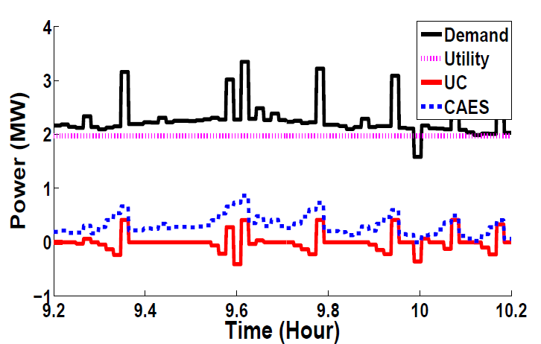
Charge/Discharge Control for MSN demand
CAES takes a bulk of the gap for significant portions of time
Ultra-capacitor is used for sudden spikes and gets charged from CAES
Notes:
Until now, we have only looked at overall summary results. Now let’s zoom in a small time window of the MSN power profile and see the operations of different ESDs to shave the original peak.
The black solid line is the original power profile and this dotted line is what actually drawn from utility, the blue and read line are discharge/charge behaviors of CAES and UC. Negative spikes represent charging.
As can be seen, CAES takes a bulk of the gap for significant portions of time.
However, when there is a sudden spike, the ultracapacitors meets the difference. And interestingly, we found that UC is charged from CAES rather than pose an additional load on utility.

Slide 52
Conclusion
Room for improvement in data center Cap-ex (and Op-ex)
We have been studying the utility of energy storage along with IT-based knobs
Our Papers on this topic:
[Eurosys’09]: overbooking techniques
[ISCA’11]: op-ex savings (peak pricing)
[Sigmetrics’11]: op-ex savings (time of day)
[HotPower’11]: reliability modeling
[Asplos’12]: under-provisioning for cap-ex savings
[Sigmetrics’12]: hybrid storage
[Mascots’14]: IT control for op-ex
Questions?
Notes:
Before we try to answer these questions, we need to understand the feasibility concerns related to using UPS batteries

